Slide 1
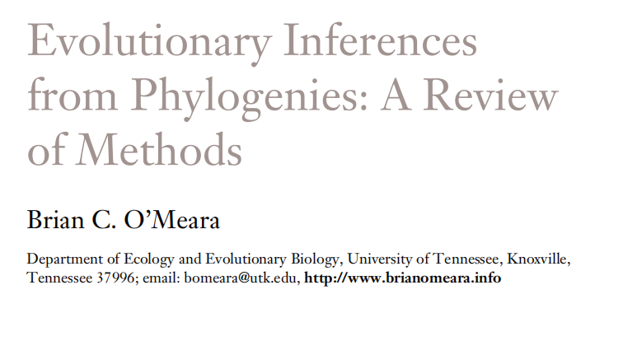

Slide 2
Jukes-Cantor Model (JC69)
Q matrix (instantaneous rates)
A C G T
A -3β β β β
C β -3β β β
G β β -3β β
T β β β -3β
Q =

Slide 3
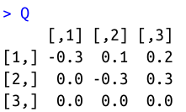
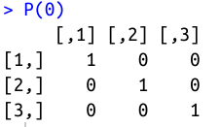
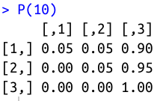
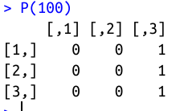
Transition probabilities:
P = e^{Qt}
Matrix exponentiation

Slide 4
JC69 is our most basic model. We will be able to do amazing things with generalizations of this one model!
A C G T
A - β β β
C β - β β
G β β - β
T β β β -
Q =

Slide 5
Back to biology - Are JC69's assumptions realistic?
Assumptions of JC69:
1. All substitutions equally likely
2. Base frequencies equal
3. Every site has equal probability of substitution
4. Process is constant through time
5. Sites are independent of each other
6. Substitution is Markovian (memoryless)
7. All sites have the same evolutionary history
Can we relax any of these assumptions?

Slide 6
Back to biology - Are JC69's assumptions realistic?
Assumptions of JC69:
1. All substitutions equally likely
2. Base frequencies equal
3. Every site has equal probability of substitution
4. Process is constant through time
5. Sites are independent of each other
6. Substitution is Markovian (memoryless)
7. All sites have the same evolutionary history
Can we relax any of these assumptions?

Slide 7
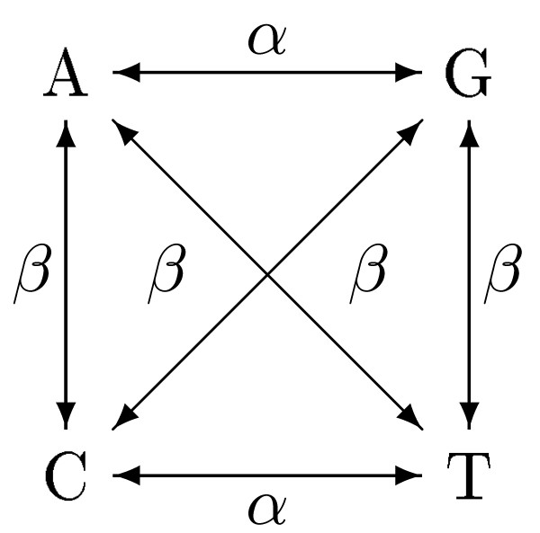
Kimura 2 Parameter model: K2P
A C G T
A - β α β
C β - β α
G α β - β
T β α β -
Q =

Slide 8
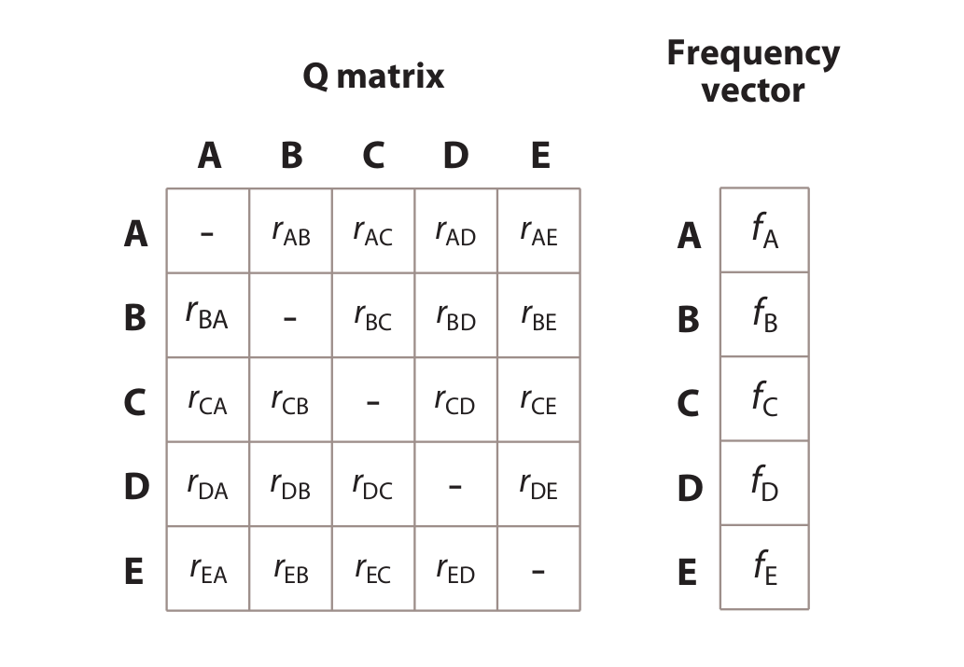
Our general CTMC model:

Slide 9
Differences between statistical phylogenetics and parsimony
Branch lengths in expected # of changes vs. minimum # of changes
Probabilistically incorporate all possible paths, not just the shortest path
Flexibility to modify and compare models
Can easily convert branch lengths to time (w/fossils or other constraints)
All data informative, not just parsimony-informative sites

Slide 10
Representing hypotheses & processes with transition matrices (Important skill!!)

Slide 11
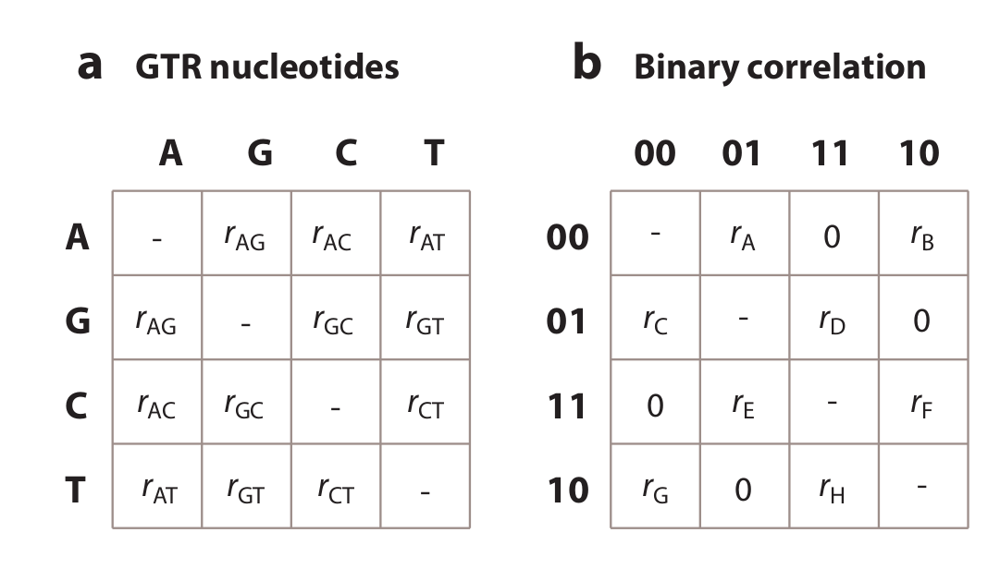
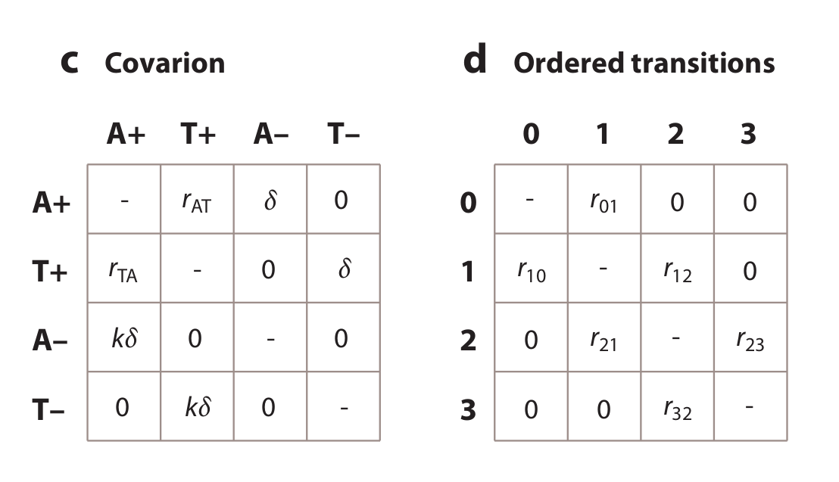
How many parameters for each? What do the models suggest about evolution?
A. B.
C. D.

Slide 12
Back to biology - Are JC69's assumptions realistic?
Assumptions of JC69:
1. All substitutions equally likely
2. Base frequencies equal
3. Every site has equal probability of substitution
4. Process is constant through time
5. Sites are independent of each other
6. Substitution is Markovian (memoryless)
7. All sites have the same evolutionary history
Can we relax any of these assumptions?

Slide 13
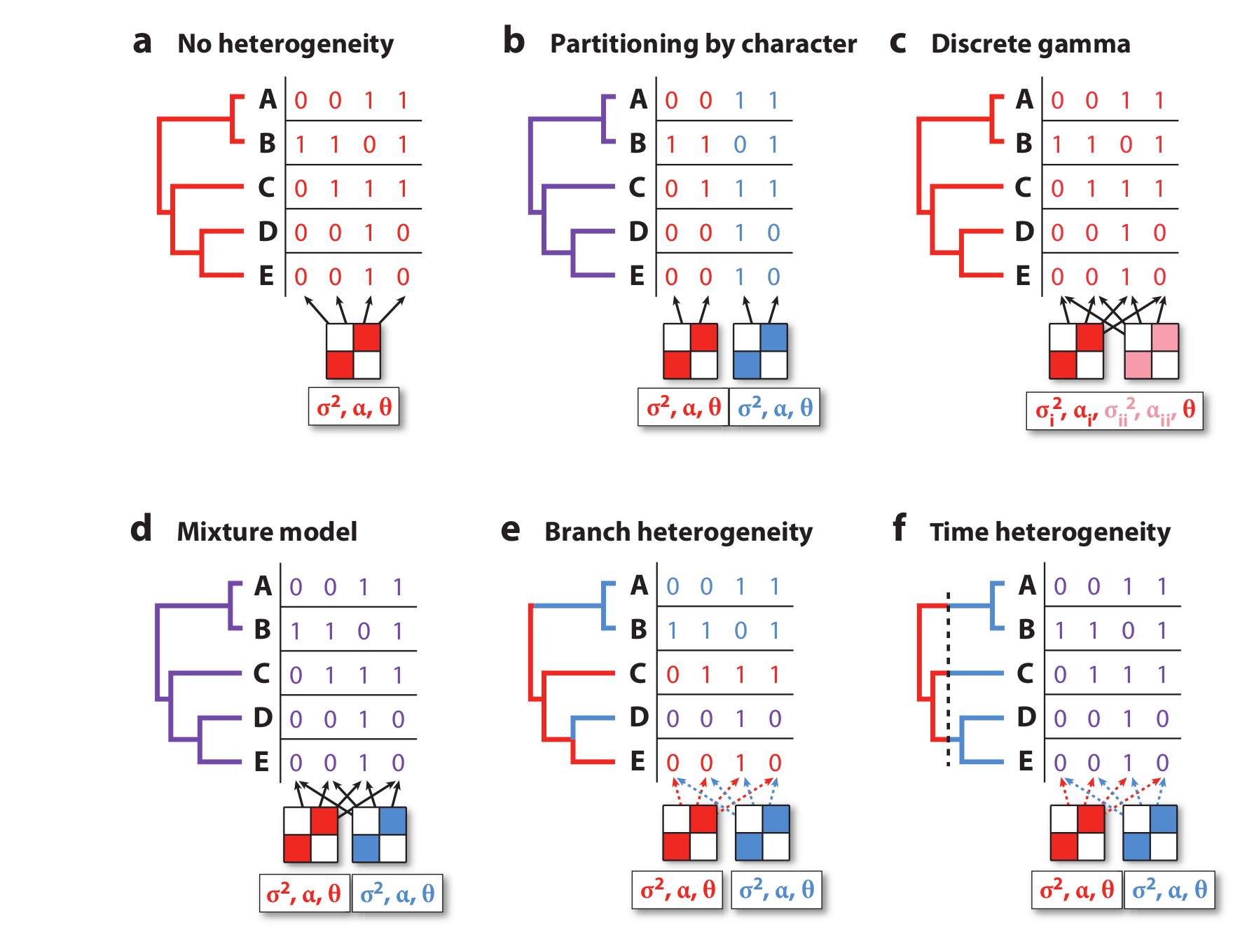
Dealing with among-site and time-heterogeneity

Slide 14


Slide 15
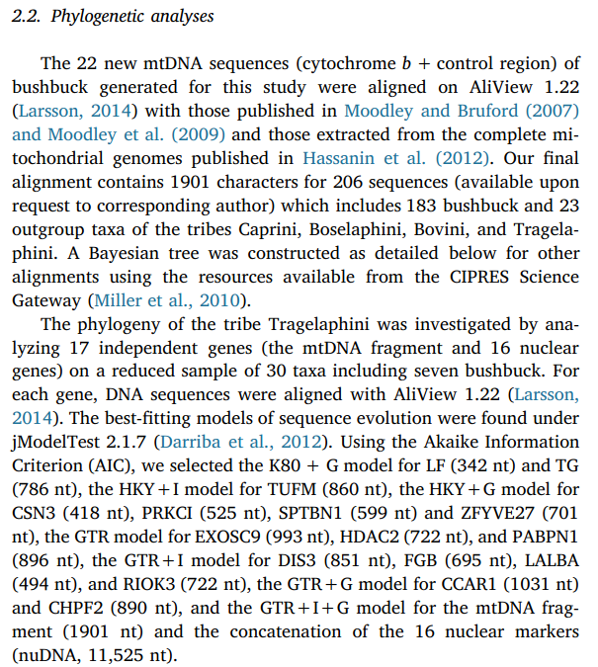

Slide 16
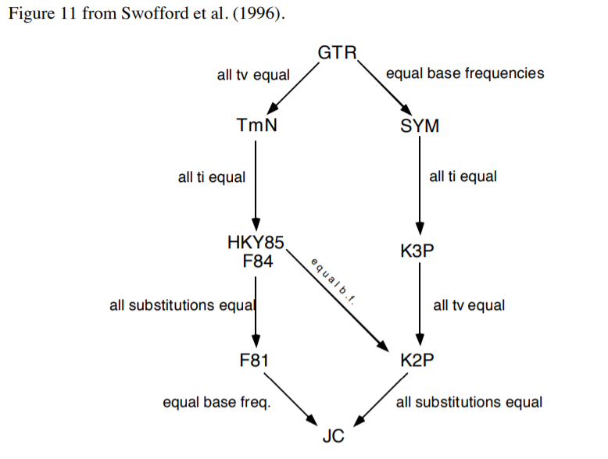

Slide 17
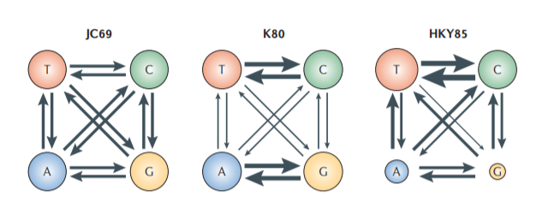
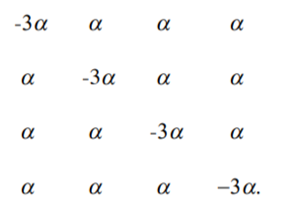
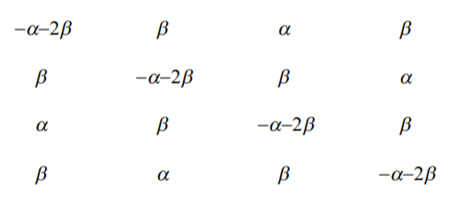
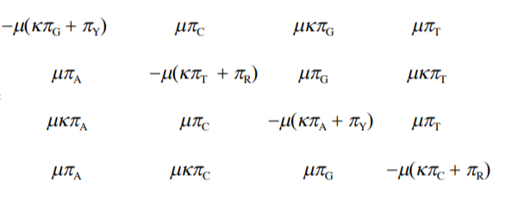

Slide 18
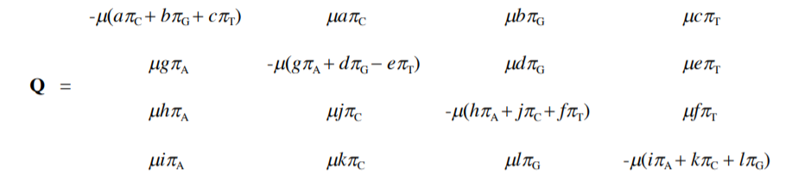
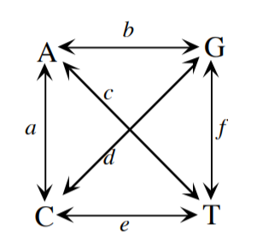
General Time-Reversible Model

Slide 19
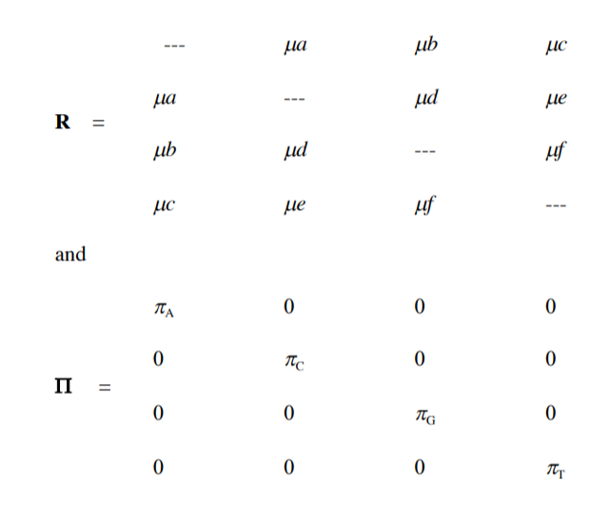
General Time-Reversible Model

Slide 20
Among-site rate variation

Slide 21
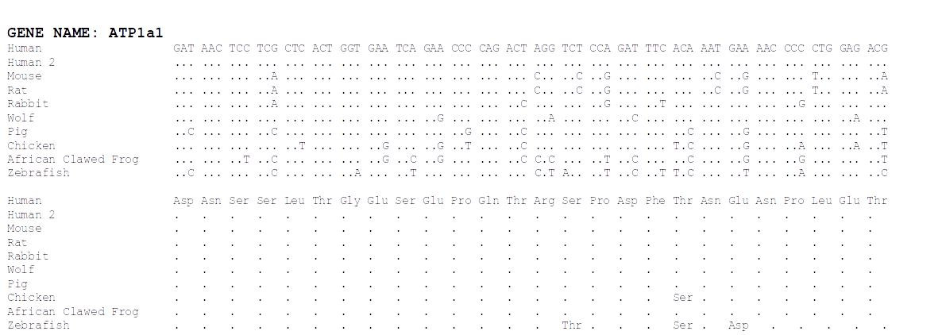
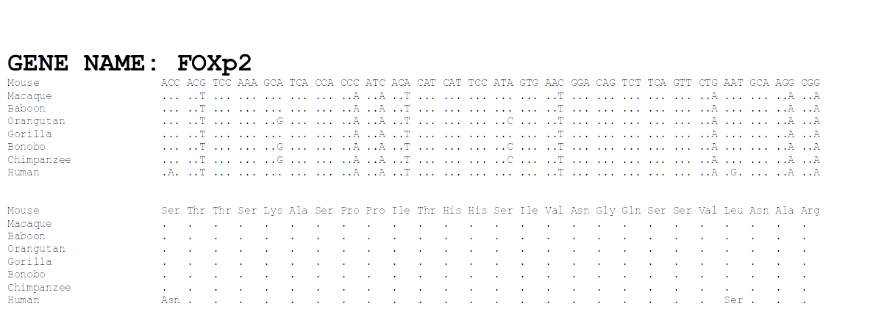

Slide 22
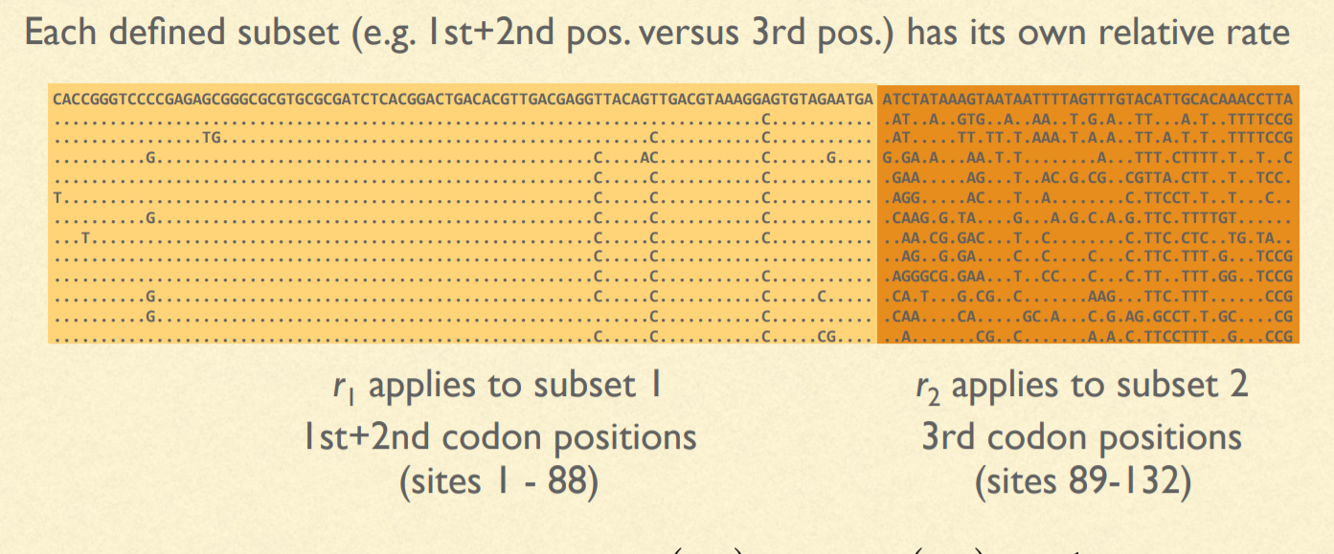
Site-specific rates

Slide 23
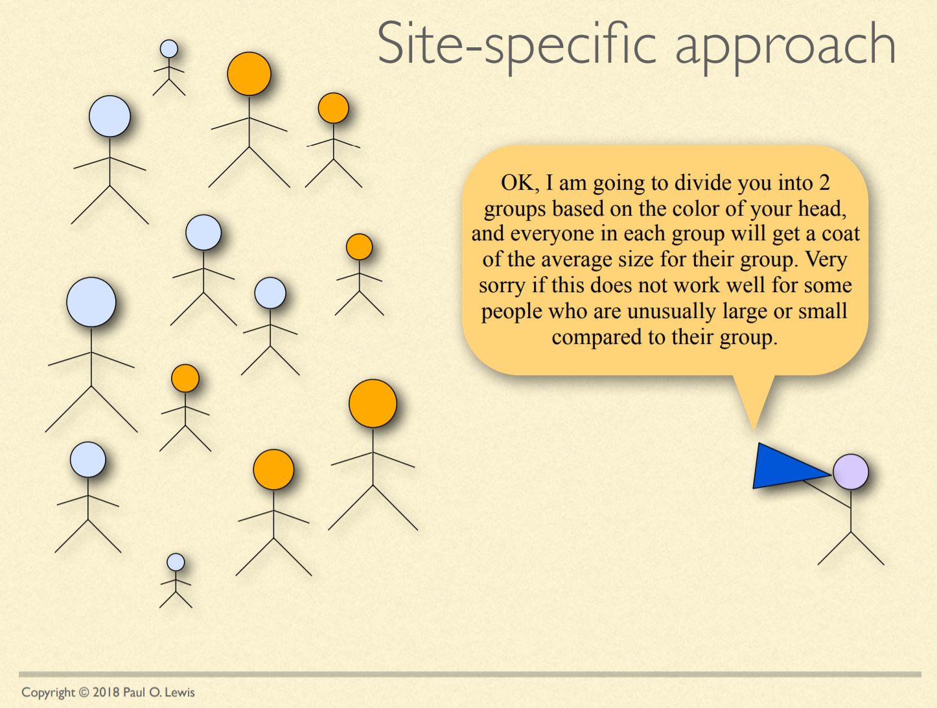

Slide 24


Slide 25


Slide 26
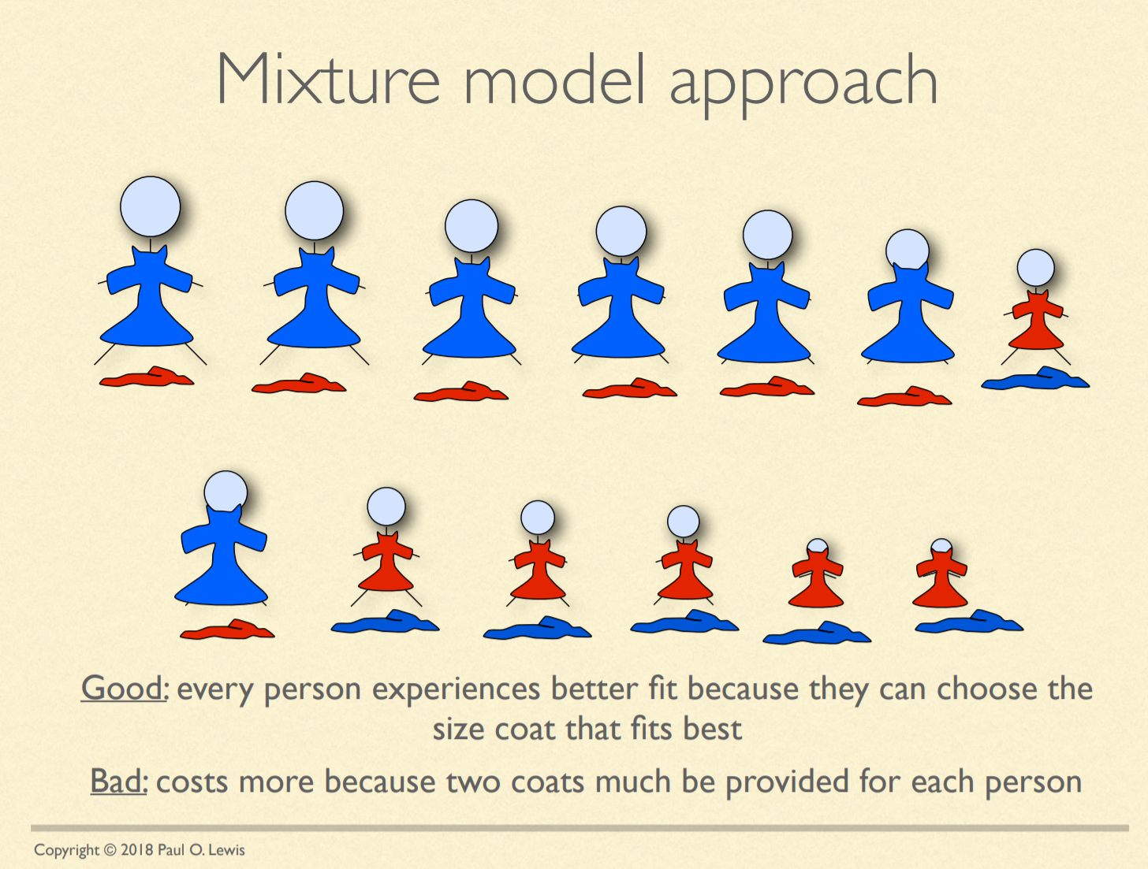

Slide 27
Invariable sites model
Every site has a probability, P_{invar} of being invariant
P_{invar} estimated from the data
Every site gets its likelihood estimated in two parts: If it were invariant & variable (as normal)
Often designated "+I" (e.g. HKY85 + I)

Slide 28
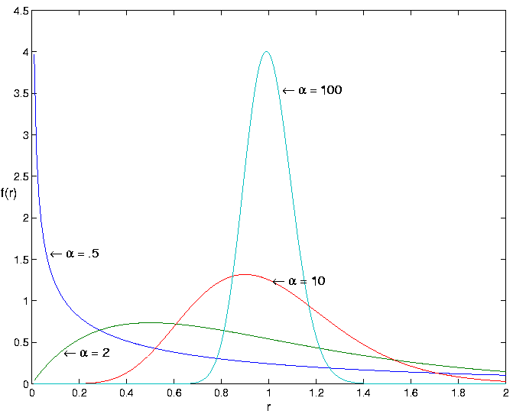
Gamma-distributed rates
Rate categories set by a discrete gamma distribution (e.g. 4 rate categories)
Estimate α
Site likelihoods calculated for each rate category and summed
" + G " or “ + Г ”
(e.g. HKY85 + I + G)

Slide 29
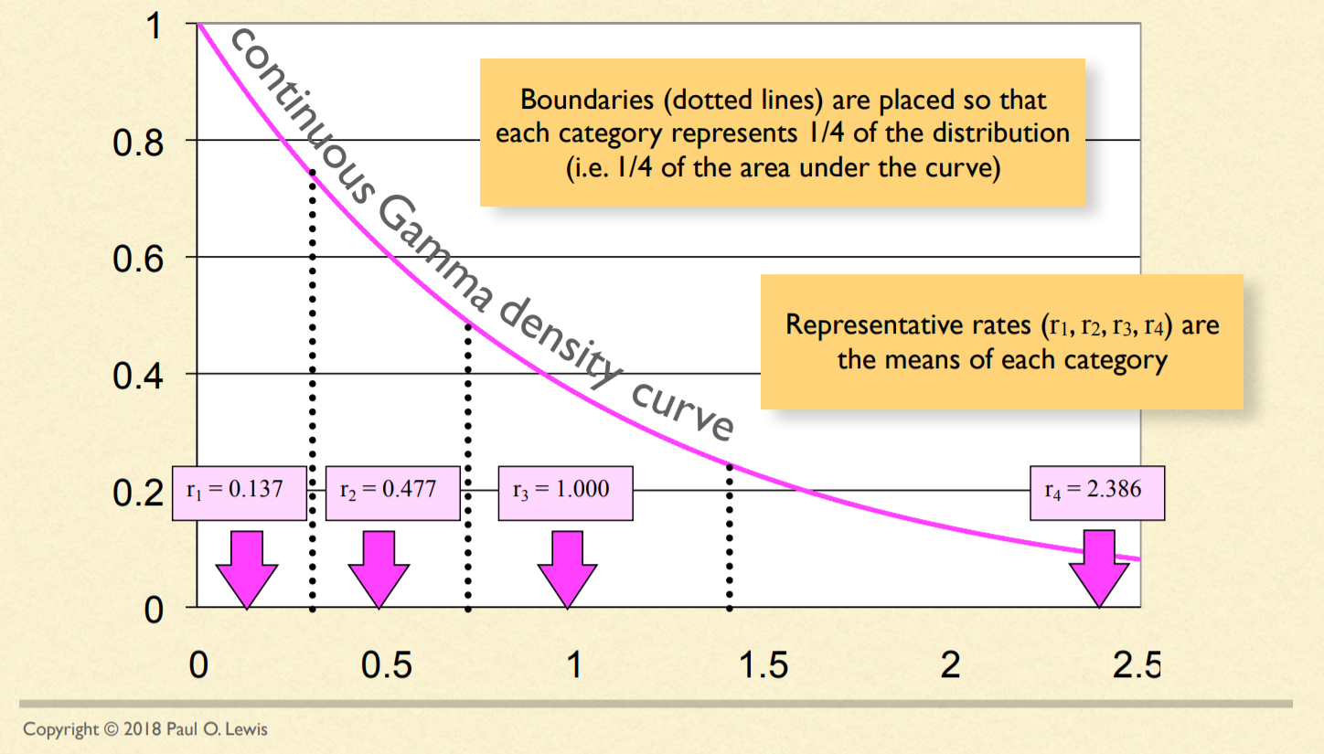
Discretizing the Gamma distribution

Slide 30
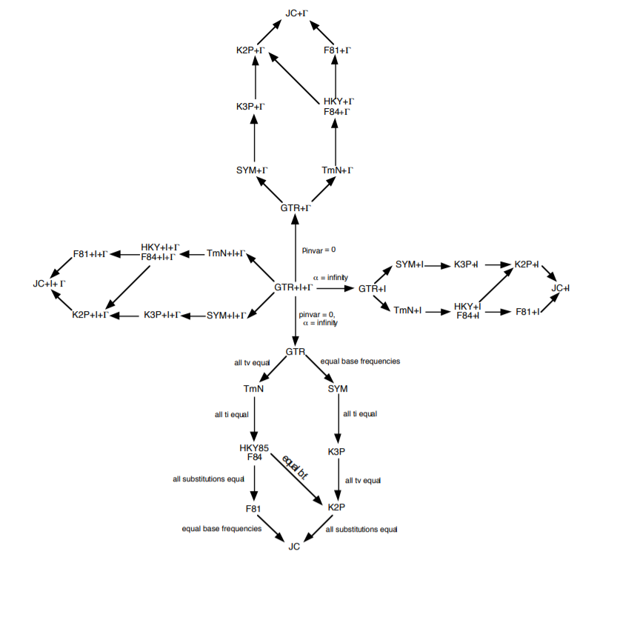
OK...but how do we decide which model to use?!?!

Slide 31
Model testing
Ideally, fit all models while simultaneously estimating tree
More practical:
Start with a not-too-bad tree, fit all the possible models, rank them by some criterion, pick the best one and use in a full analysis
Criteria: Likelihood ratio test, Akaike Information Criterion, Bayesian Information Criterion, Decision Theory, Bayesian model selection, Bayesian hypothesis testing or model averaging

